Slide 1
Getting Started with the SharePoint Framework
Introducing the SharePoint Framework

Slide 2

Introducing the SharePoint Framework (SPFx)
What is the SharePoint Framework?
Where is the SharePoint Framework supported?
Configuring your Office 365 developer tenant for SPFx development

Slide 3


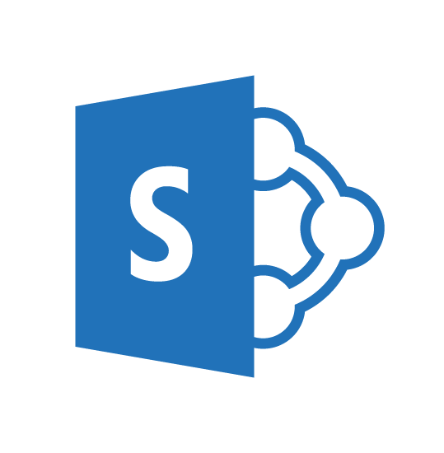
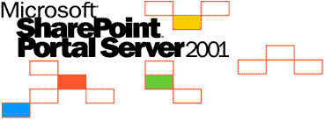
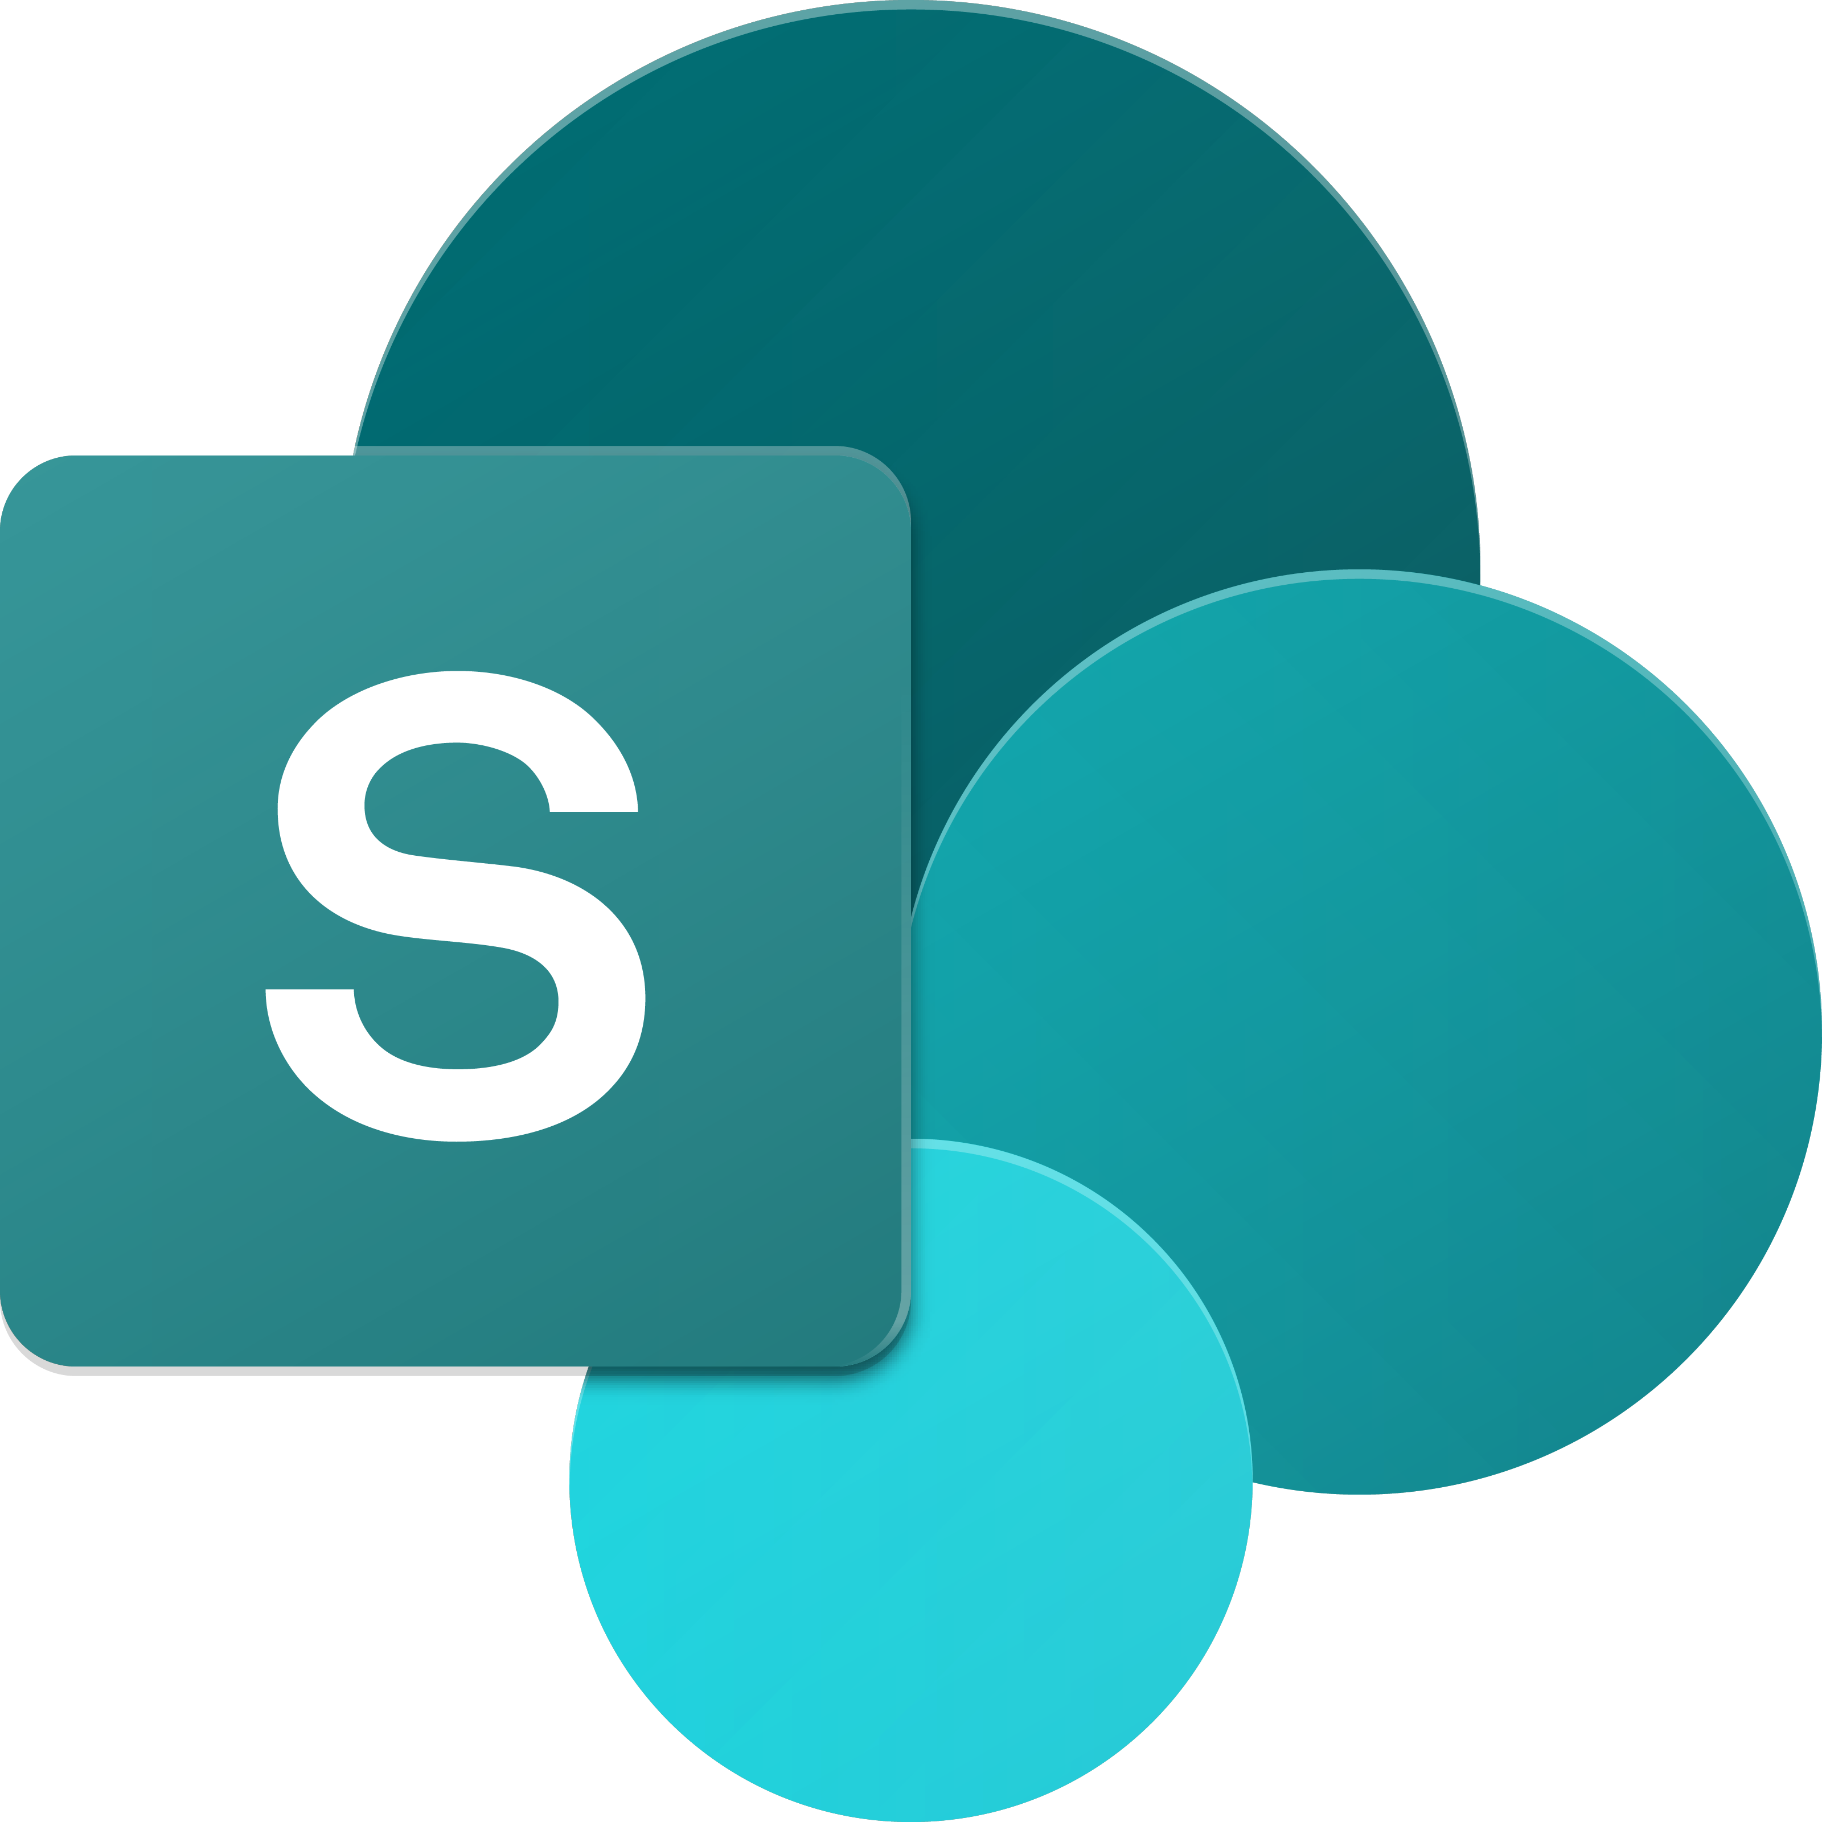
SharePoint UX – Evolving cross versions
SharePoint
Portal Server 2001
SharePoint
Portal Server 2003
Office SharePoint
Server 2007
SharePoint
Server 2010
SharePoint
Server 2013
SharePoint
Server 2016, SPO
2001
2003
2006
2009
2012
2016 …
ASP
Early Server Widget Tech
Single Box
ASP.NET
WebParts
CAML
SharePoint Publishing
FAST acquisition
Shared Services (e.g. taxonomy)
First Client-Side Rendering Using XSL
Search driven publishing sites
Client-Side Rendering sprinkled in, e.g. CBS, MDS, etc.
Hybrid
Modern standalone cloud apps, e.g. O365 Video, Delve, etc.
…
SPFx and Office Fabric
Modern SharePoint pages
Notes:
Tahoe/SPS 2001 – ASP Based, Single Box
SP 2003 – Moved to ASP.NET, scale out, enterprise manageability
SP 2007 – Added ECM, Publishing, Shared Services
SP 2010 – FAST acquisition, search driven portals, scaled up doclibs
SP 2013 – Multitenant, base for our cloud based release
SP 2016 – First version migrated back from Cloud

Slide 4

SharePoint Framework Extensibility Principles Build long-term, value-added services for enterprise mobility
Principles
To provide an Application Development Framework that aligns 1st and 3rd parties
To build industry leading client-side solutions On-Premises and in the Cloud
Unlocking the potentials of SharePoint and the Microsoft Graph on desktops or any device
Notes:
Over the past several years, with the evolution of Office 365, development of SharePoint solutions has encountered a new set of challenges: while on one hand IT and Tenant administrators require a new set of tools to control how data get accessed and consumed in their tenancies, developers, on the other hand, want to programmatically control the whole lifecycle, experience, and data access capabilities of a Site.
Unfortunately, developers today find themselves constraint around building app parts as a result of iFrames, a reduced set of APIs, and no integration with cross Office 365 workloads. This in turn limits their ability to develop powerful portals that extend SharePoint.
The client-side development framework will deliver capabilities that will help both first party and third party developers build powerful, rich applications and provide an enjoyable web experience in Office 365 for end users that are both intuitive and simple to consume.

Slide 5
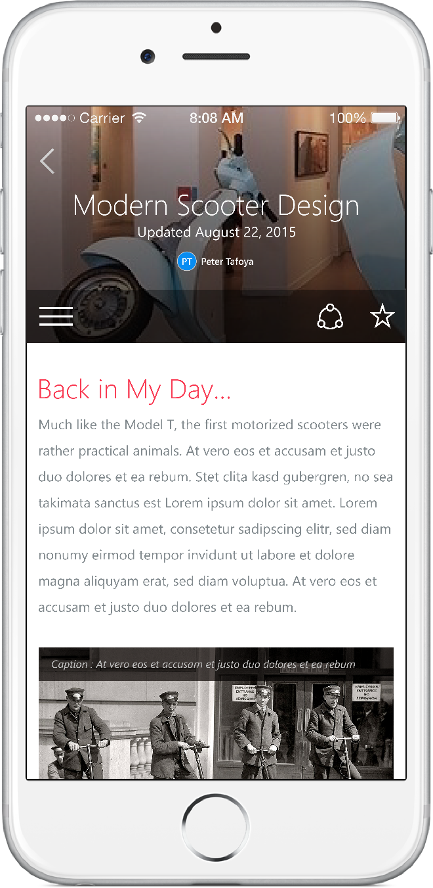
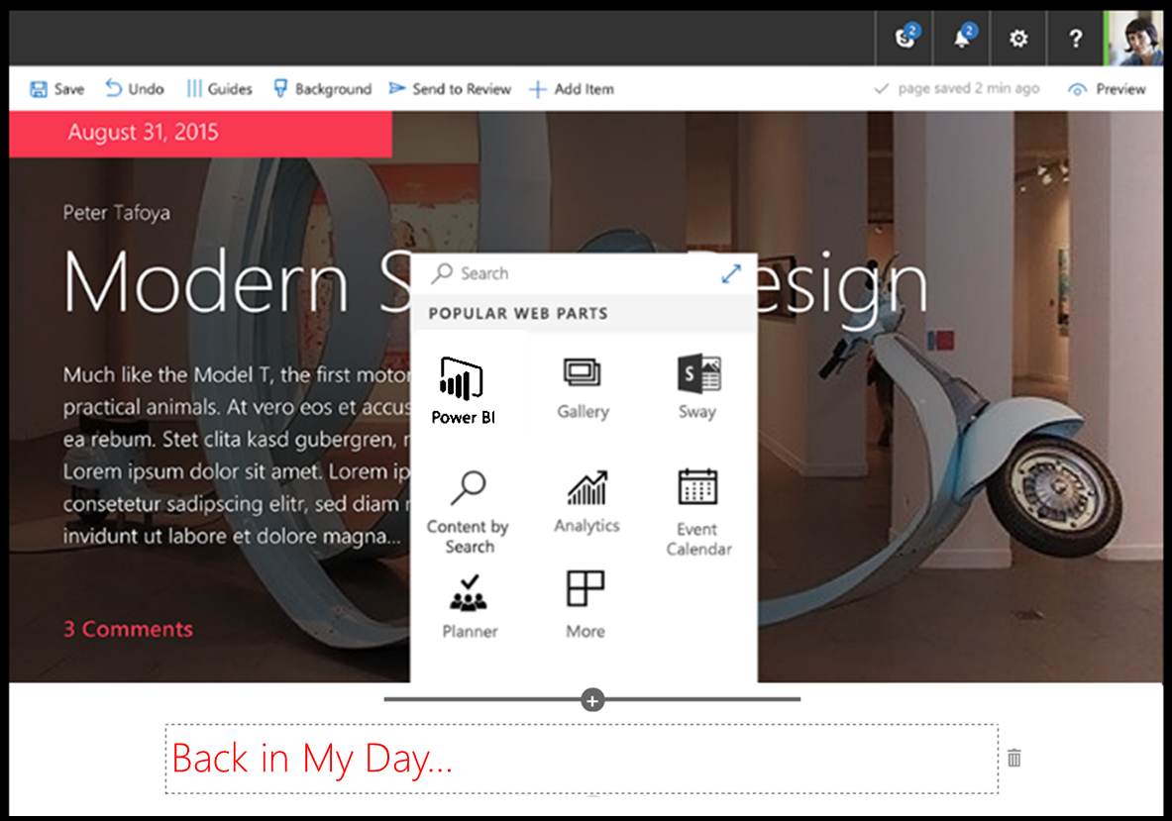
SharePoint Framework
Modern client-side development
Lightweight web and mobile
Powers our own experiences
Backward compatible
Supports open source tools & JavaScript web frameworks
SharePoint Framework
Microsoft Graph
LOB Systems and Cloud Services
Notes:
Built into the SharePoint mobile apps

Slide 6

What’s a modern page?
Client-side rendered
Natively responsive
Client-side web parts
Client-side and persisted caches
Mobile optimized
Notes:
Client-side rendered using Open Source web tech
CDN deployed web apps with client side interactivity and fast page routing
Client-side web parts
Client-side and persisted caches
Mobile optimized (responsive)

Slide 7
Modern Site Pages
Easily create powerful, beautiful looking pages
Communicate ideas and information using our new authoring canvas and gallery of web parts.
Modern building blocks
Authoring canvas and web parts are built using client-side HTML and JavaScript. Pages are reusable in custom applications
Mobile support is built in from the start
Content reflows across device sizes and pages are fast and fluid.
Pages get better with the Microsoft Graph
Authors can leverage Microsoft Graph to surface relevant pages to the people that need to read them.

Slide 8
Is all SP Online development in JavaScript?
In similar ways as with SharePoint Add-in model, server-side development is needed for back end services
No
SharePoint Framework concentrates on user interface, not on fundamentals around the API usage
You should be considering hosting your business logic and long running tasks in Azure, for example using Azure Functions or custom WebAPIs

Slide 9
Office 365 Developer Tenant Setup Steps
Sign up for an Office 365 Developer Tenant
Create app catalog site
Create a new site collection for testing – dev or normal
Use online workbench for testing your code
1-2-3

Slide 10
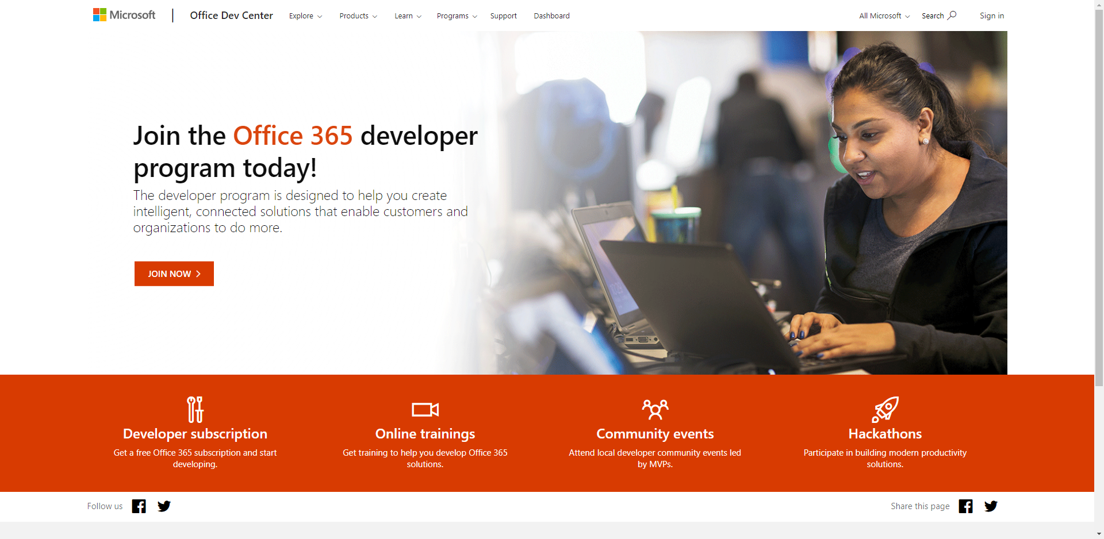
Sign up for an Office 365 Developer Tenant
Sign up for the Office Developer Program - https://aka.ms/offdp
You will receive welcome mail with link to sign up for Office 365 tenant
Notes:
To build and deploy client-side web parts using the the SharePoint Framework, you will need an Office 365 Tenant.

Slide 11
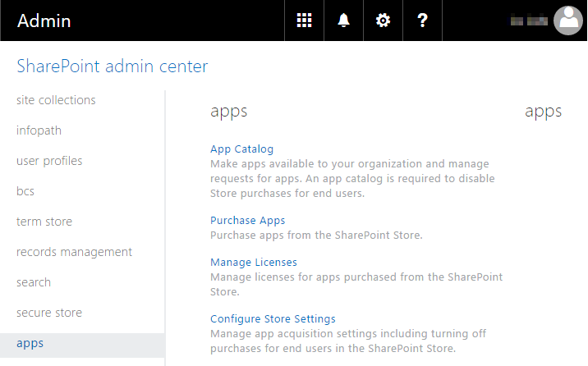
Create App Catalog Site
https://[tenant]-admin.sharepoint.com
SharePoint Framework solutions are deployed to tenant using app catalog when they are ready for distribution

Slide 12
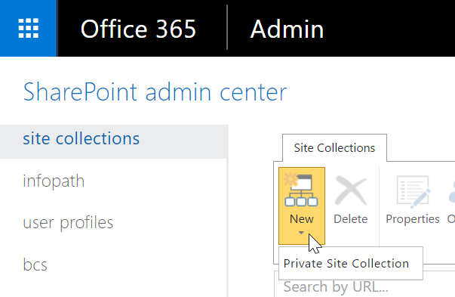
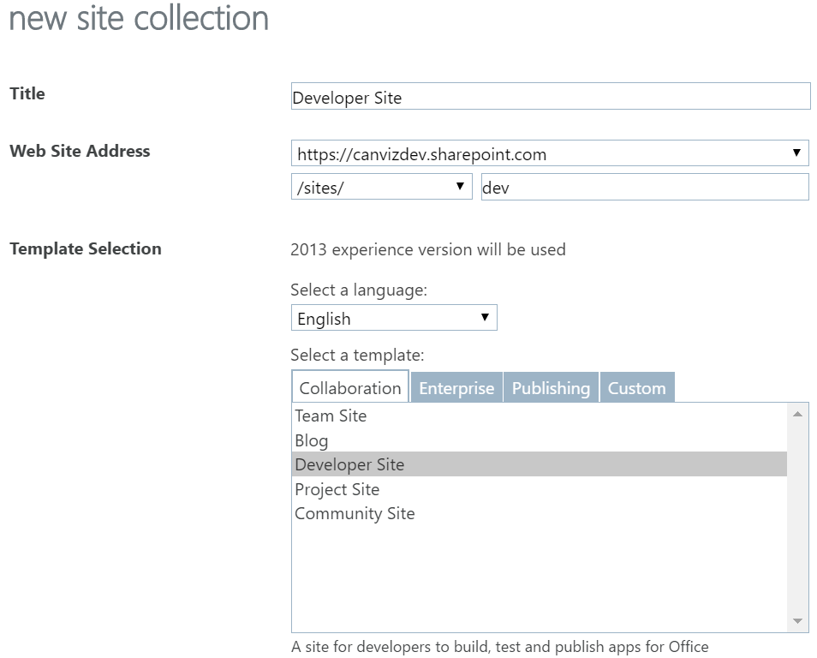
Create a new Developer Site collection
https://[tenant]-admin.sharepoint.com
Technically developer site collection is targeted for add-in development, but you need to have a location to test web parts from SharePoint Framework Online workbench

Slide 13
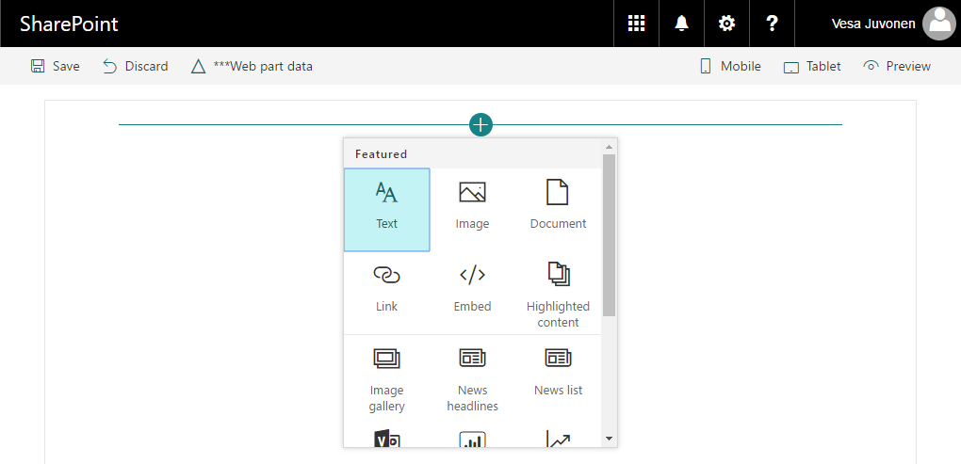
SharePoint Online Hosted Workbench
https://[sharpeointonline-site]/_layouts/workbench.aspx
SharePoint Online workbench can be accessed under any site with _layouts URL. Hosted site provides you site context where solution is executed.

Slide 14
Demo Configuring Your Office 365 Environment

Slide 15

Summary
What is the SharePoint Framework?
Where is the SharePoint Framework supported?
Configuring your Office 365 developer tenant for SPFx development

Slide 16
Reading further
SharePoint Framework
http://aka.ms/spfx
Set up your Office 365 Tenant
http://aka.ms/spfx-setup-tenant
Office Developer Program
https://aka.ms/offdp
SharePoint Developer Community (PnP)
https://aka.ms/sppnp

Slide 17
Thank you.

